Slide 1
TensorFlow tutorial: Image classification using CNN
Soo Kim
Lawrence Livermore National Laboratories

Slide 2
Outline
Preliminary
What is Neural Networks
CNN for MNIST classification
CNN for hurricane classification
Sources: Tensorflow for deep learning research: https://web.stanford.edu/class/cs20si/2017/
MNIST for ML Beginner: https://www.tensorflow.org/tutorials/

Slide 3
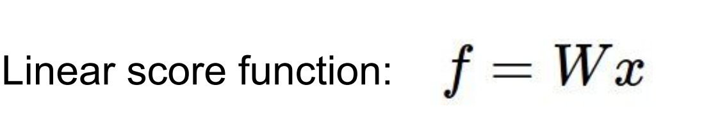
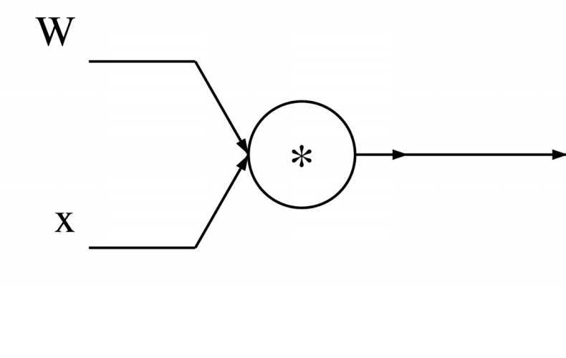
Preliminary
f = Wx

Slide 4
Preliminary
ReLU activation
W₂
W₁
f = W₂Max(0,W₁x)
ReLU

Slide 5
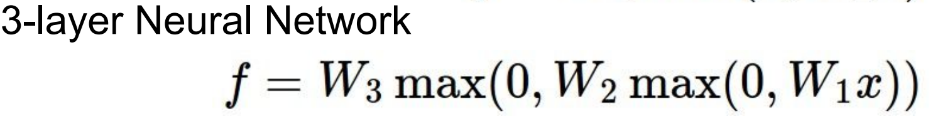
Preliminary
:

Slide 6
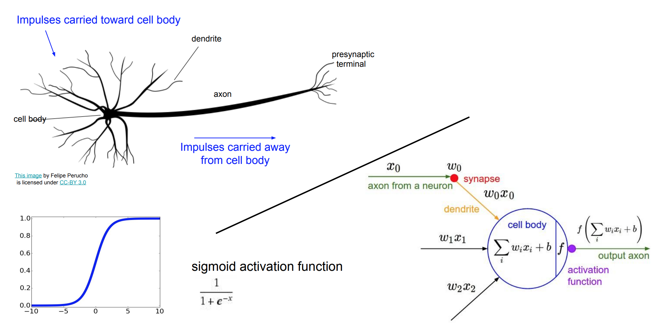
What is NN (Neural Networks) : With activation function

Slide 7
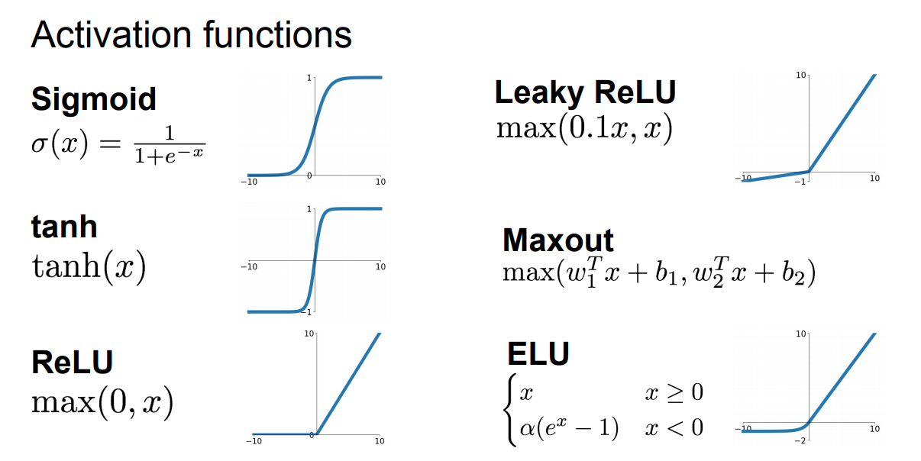
What is NN (Neural Networks)

Slide 8
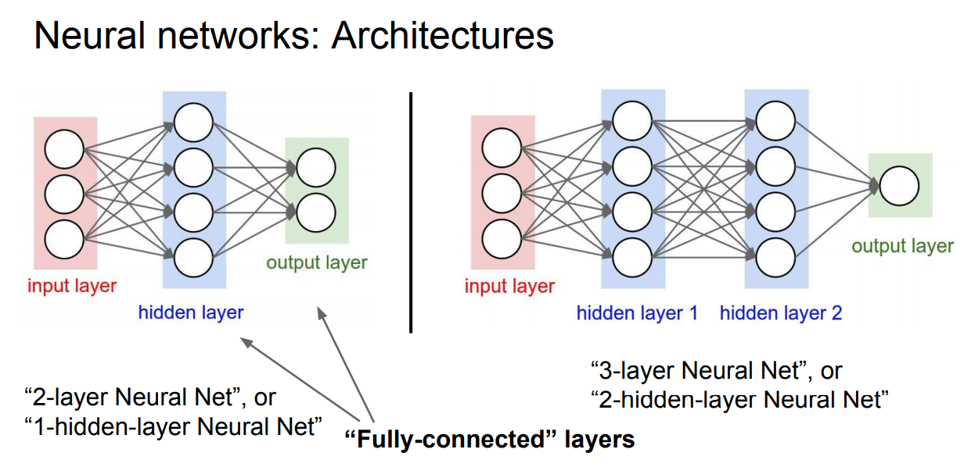
What is NN (Neural Networks)

Slide 9
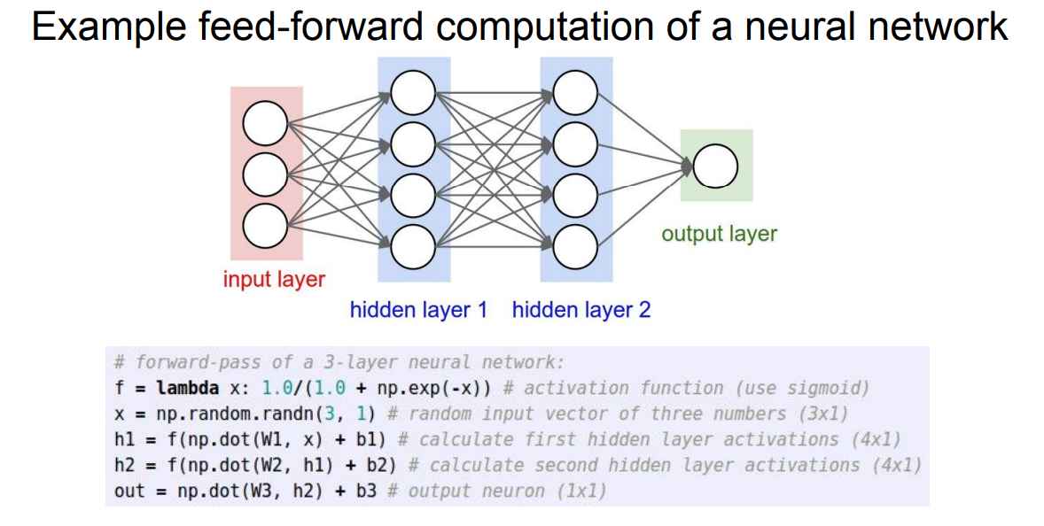
What is NN (Neural Networks)

Slide 10
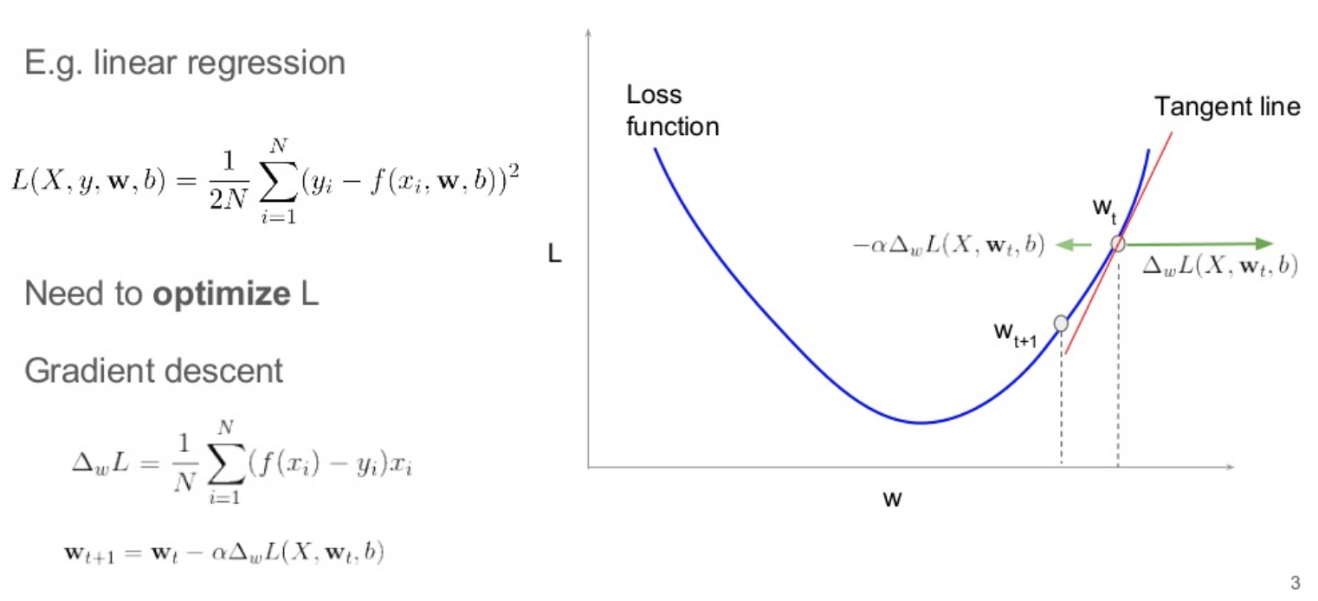
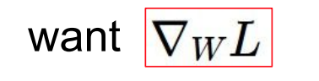
Back-propagation

Slide 11
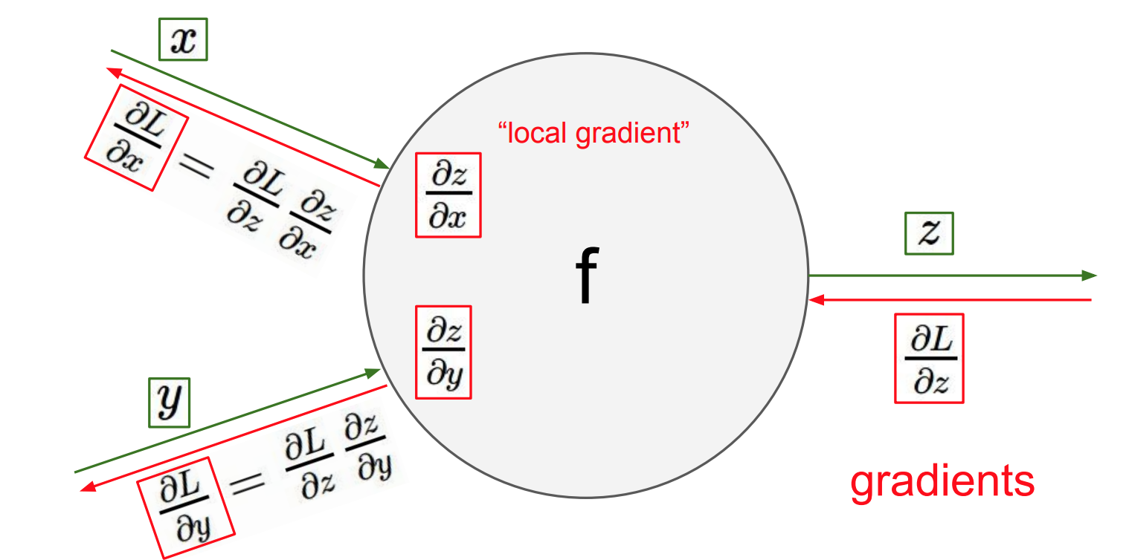
Back-propagation

Slide 12
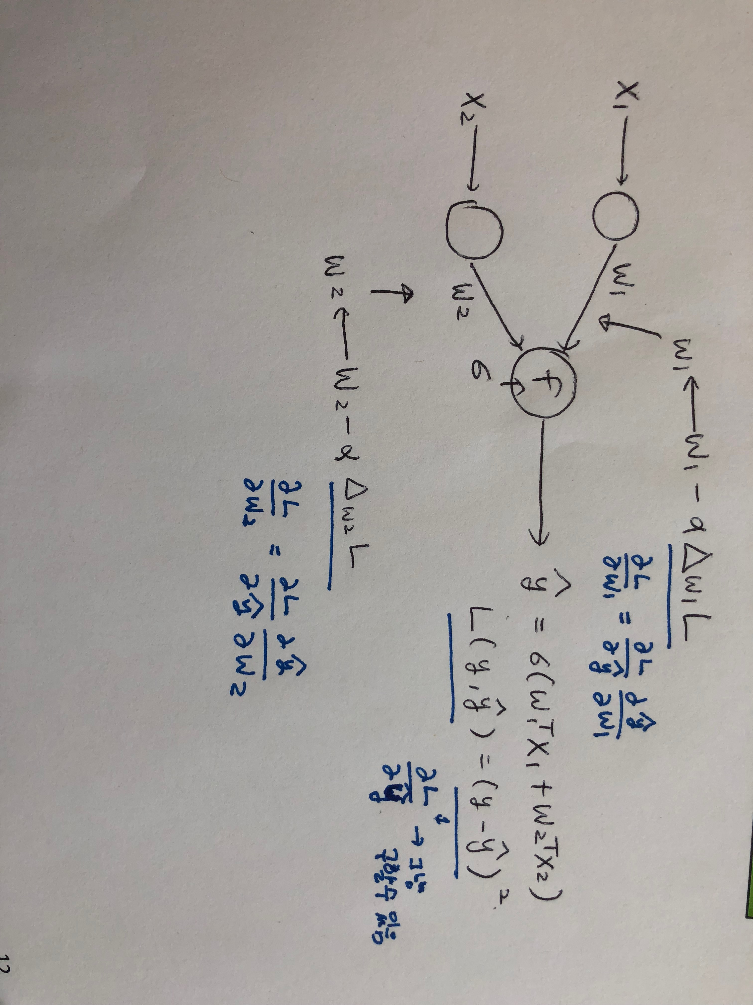
Back-propagation

Slide 13
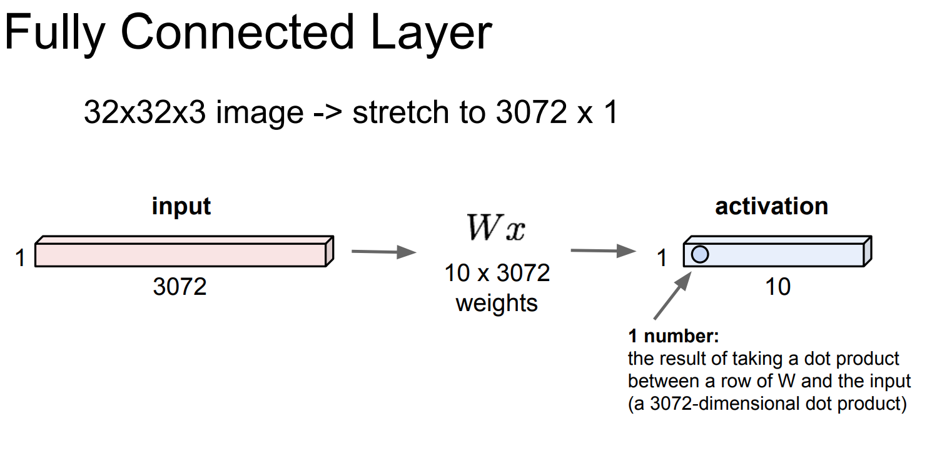
Image Classification with CNN

Slide 14
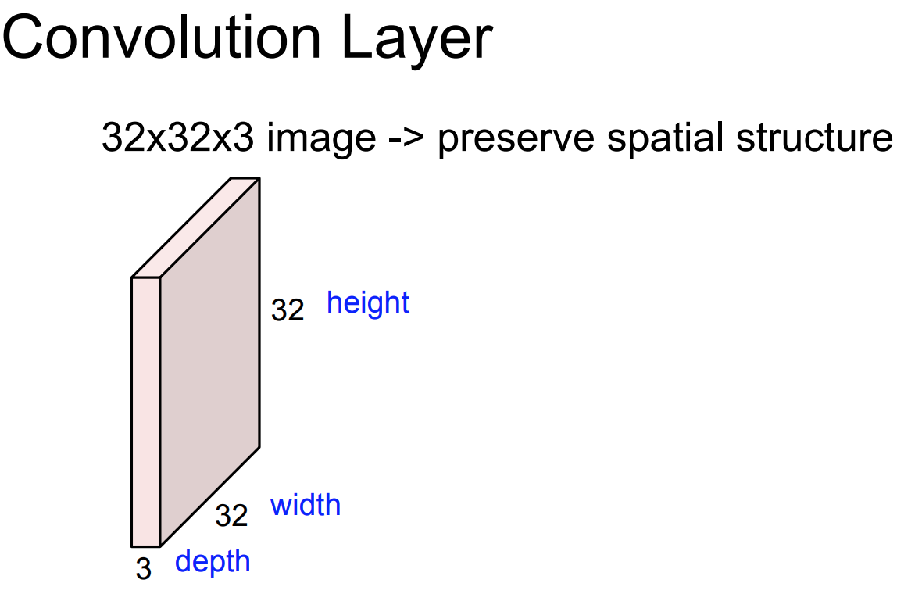
Image Classification with CNN

Slide 15
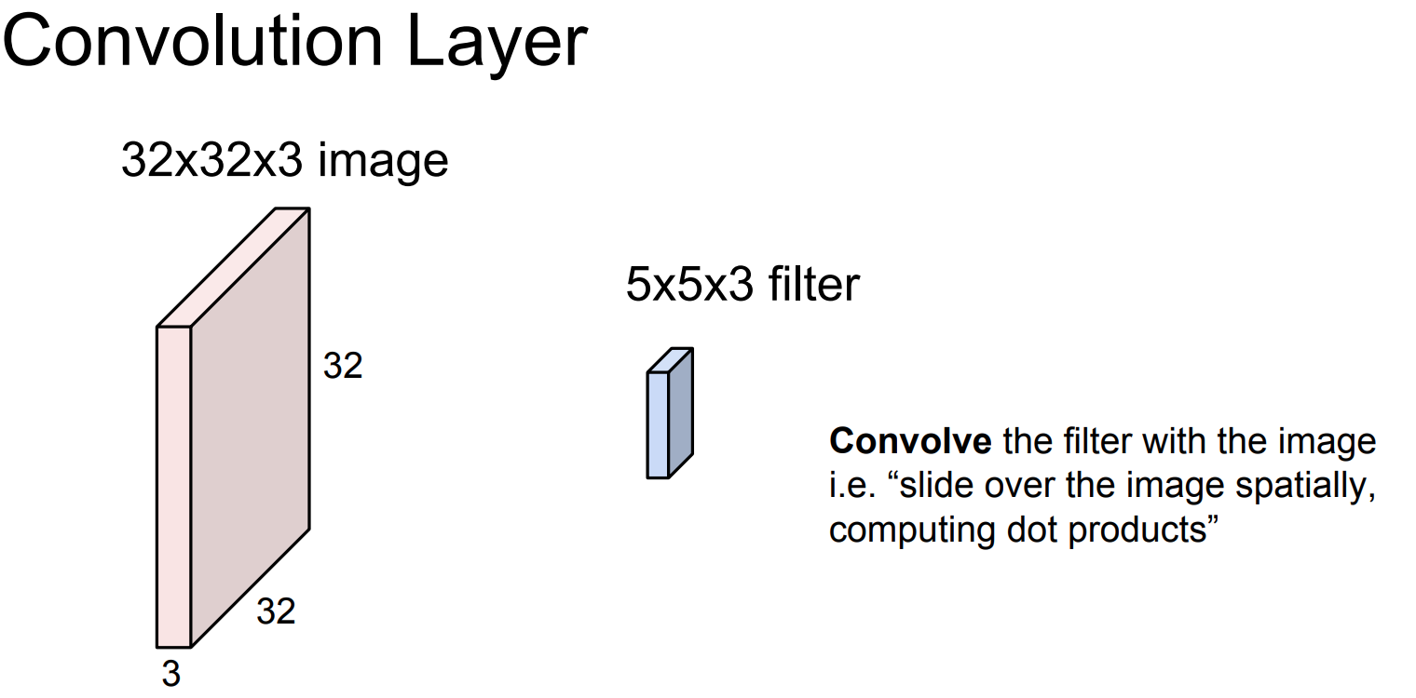
Image Classification with CNN

Slide 16
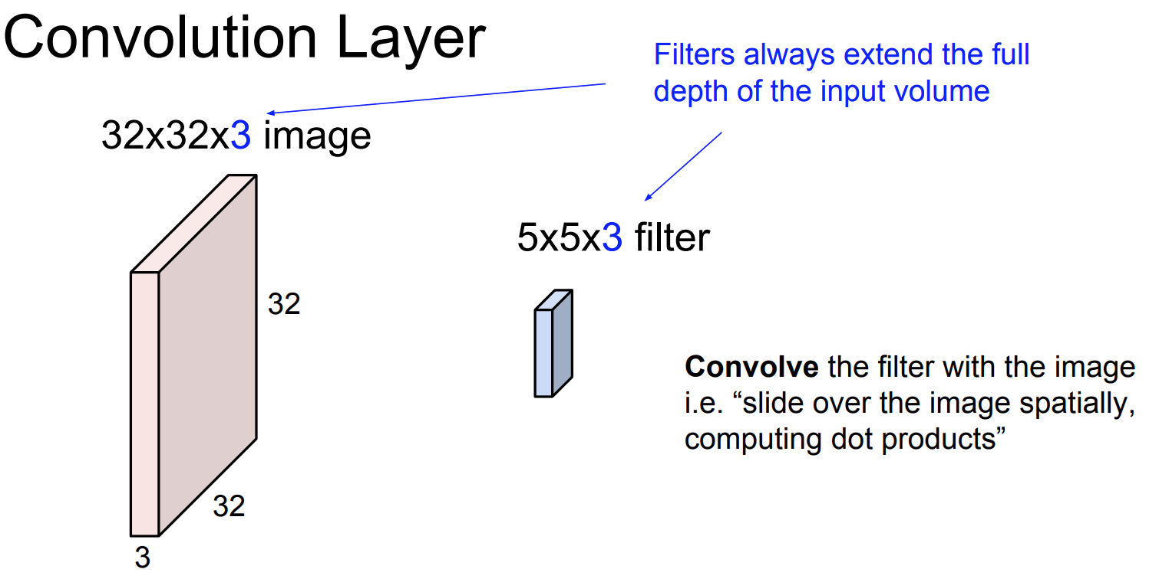
Image Classification with CNN

Slide 17
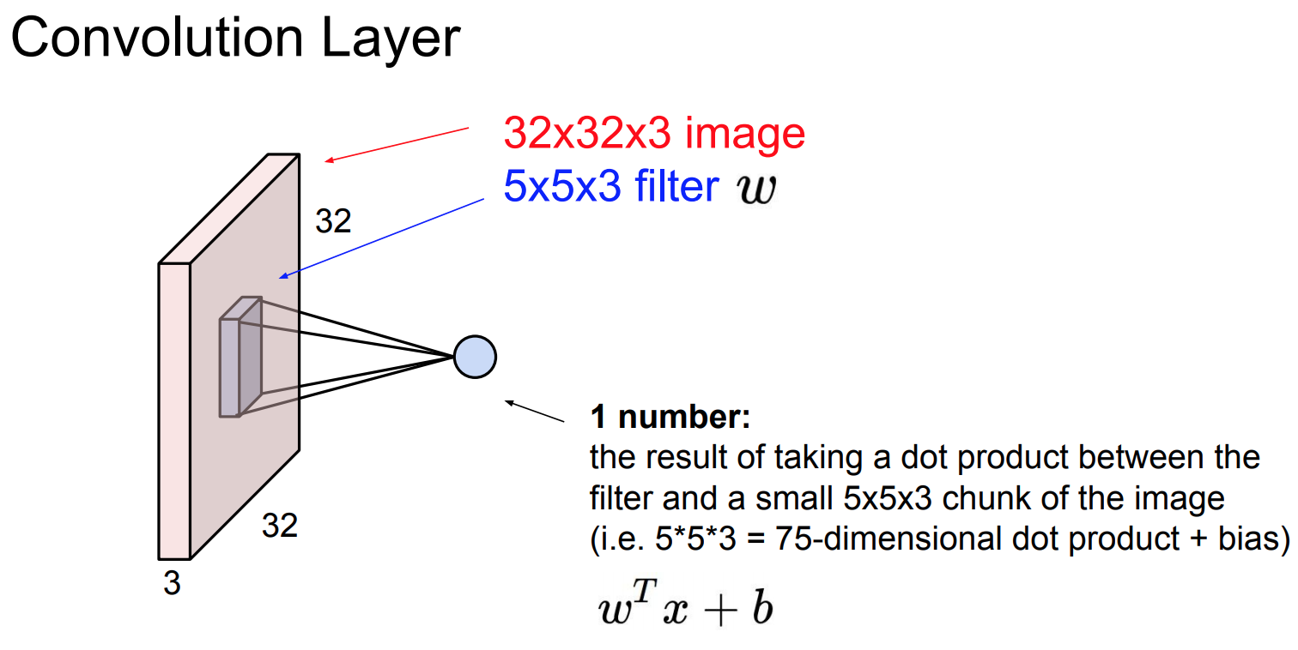
Image Classification with CNN

Slide 18
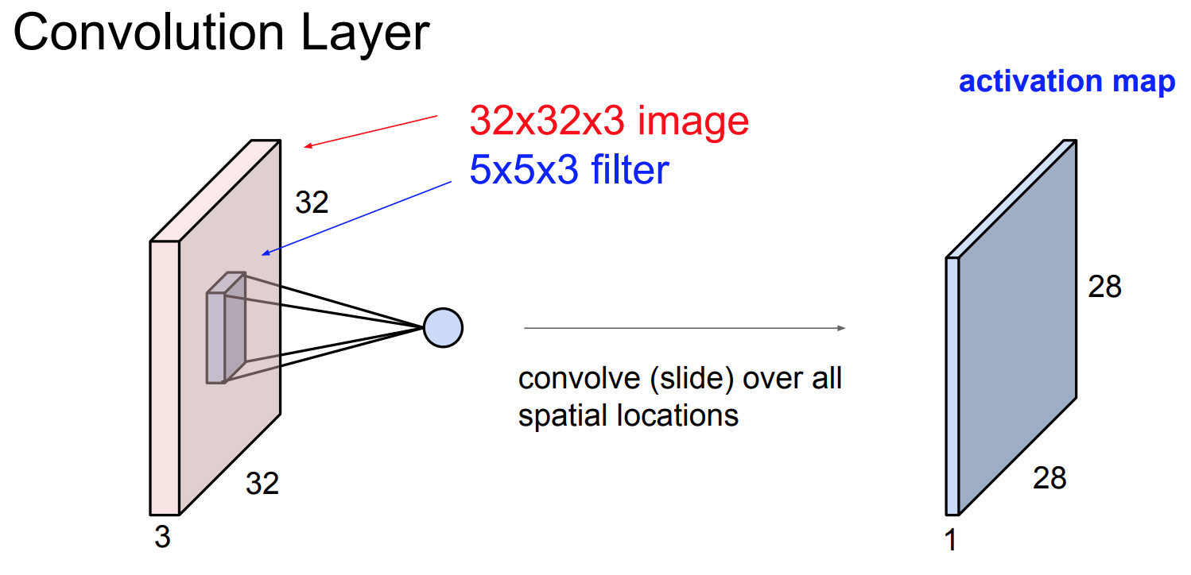
Image Classification with CNN

Slide 19
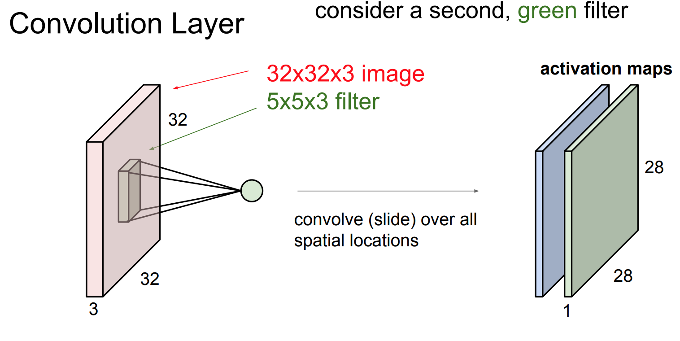
Image Classification with CNN

Slide 20
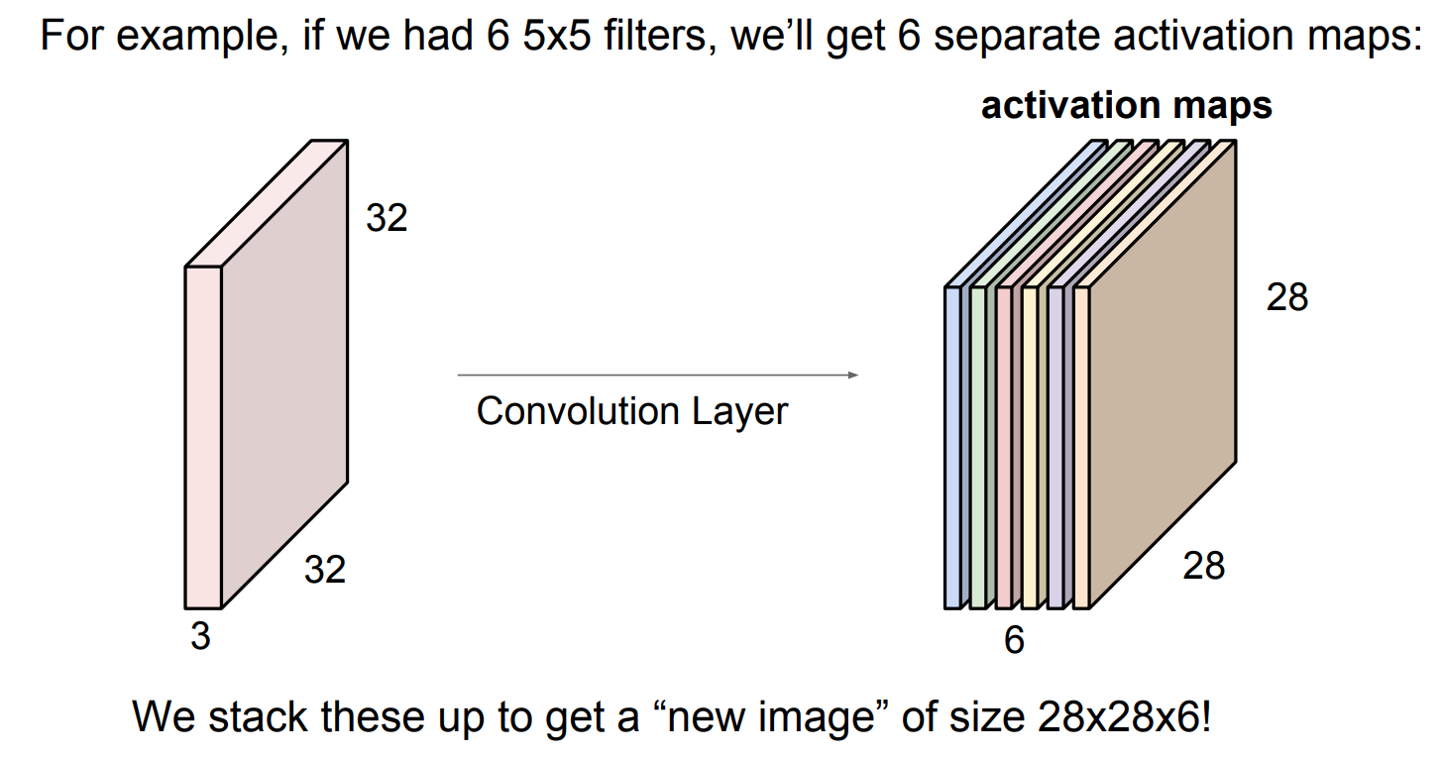
Image Classification with CNN

Slide 21
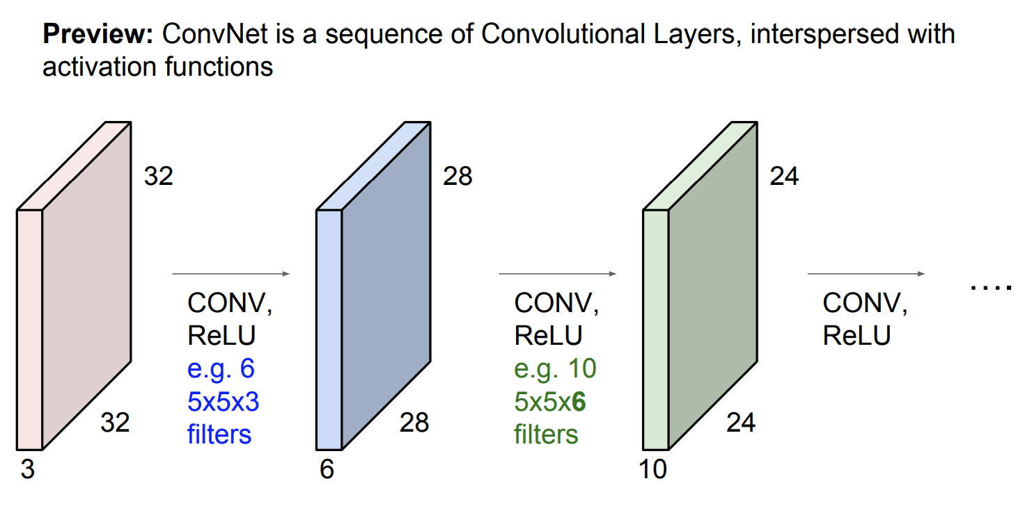
Image Classification with CNN

Slide 22
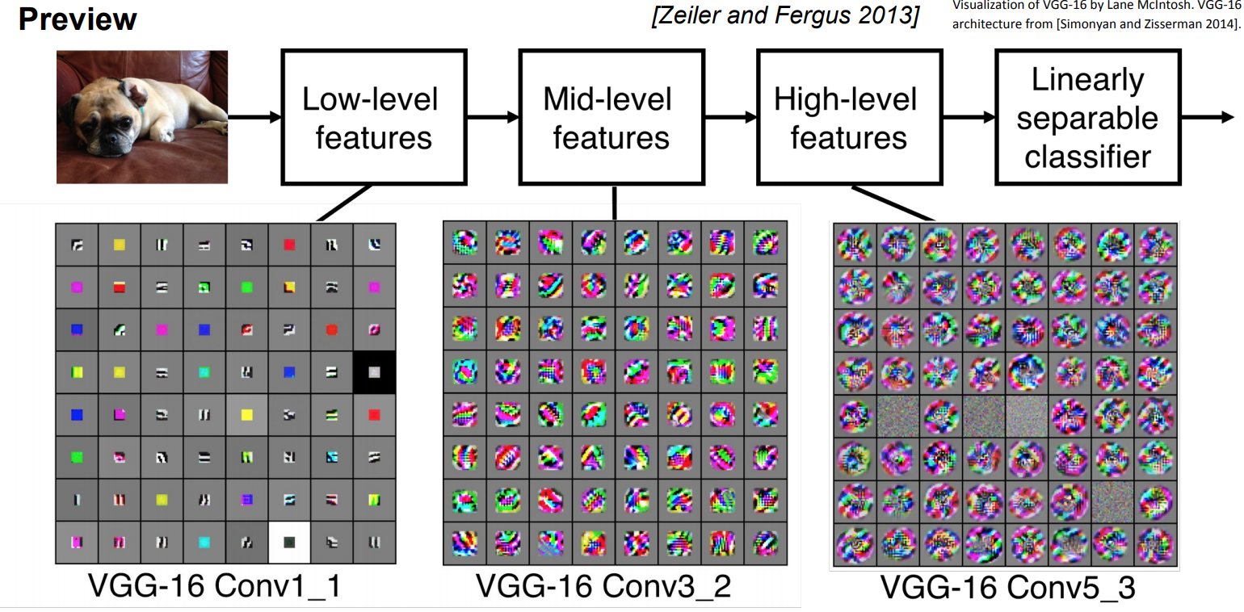
Image Classification with CNN

Slide 23
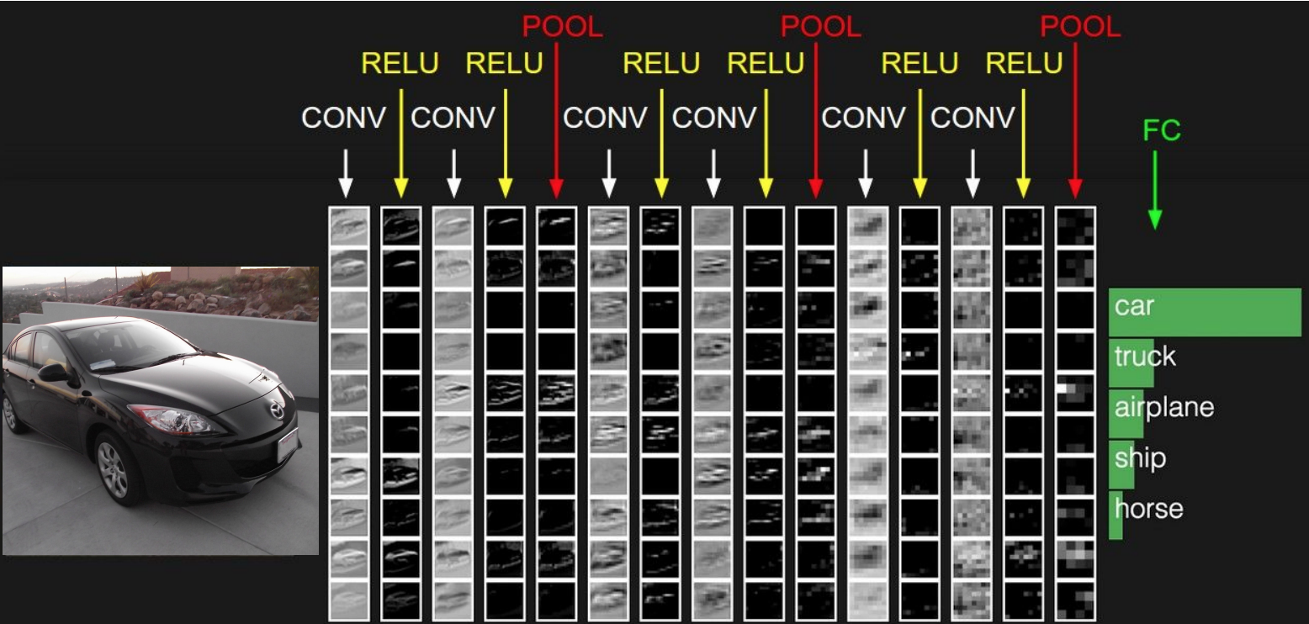
Image Classification with CNN

Slide 24
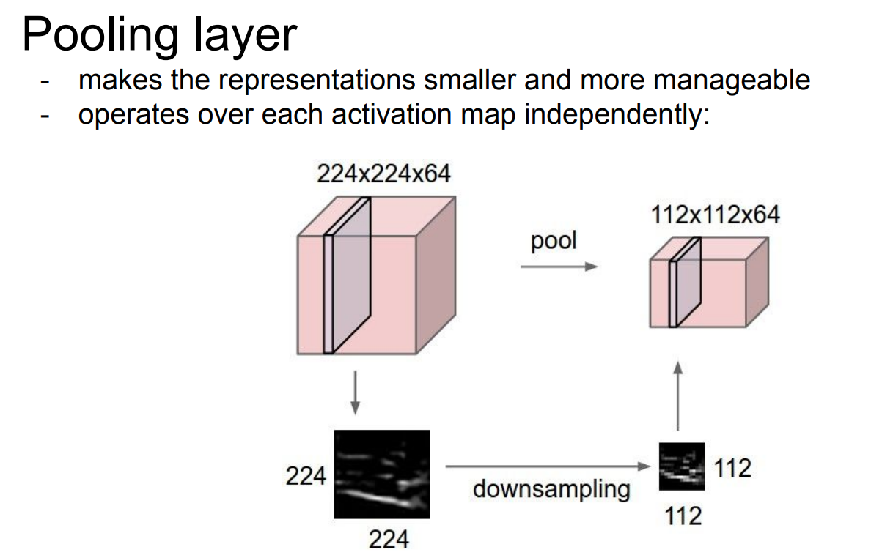
Image Classification with CNN

Slide 25
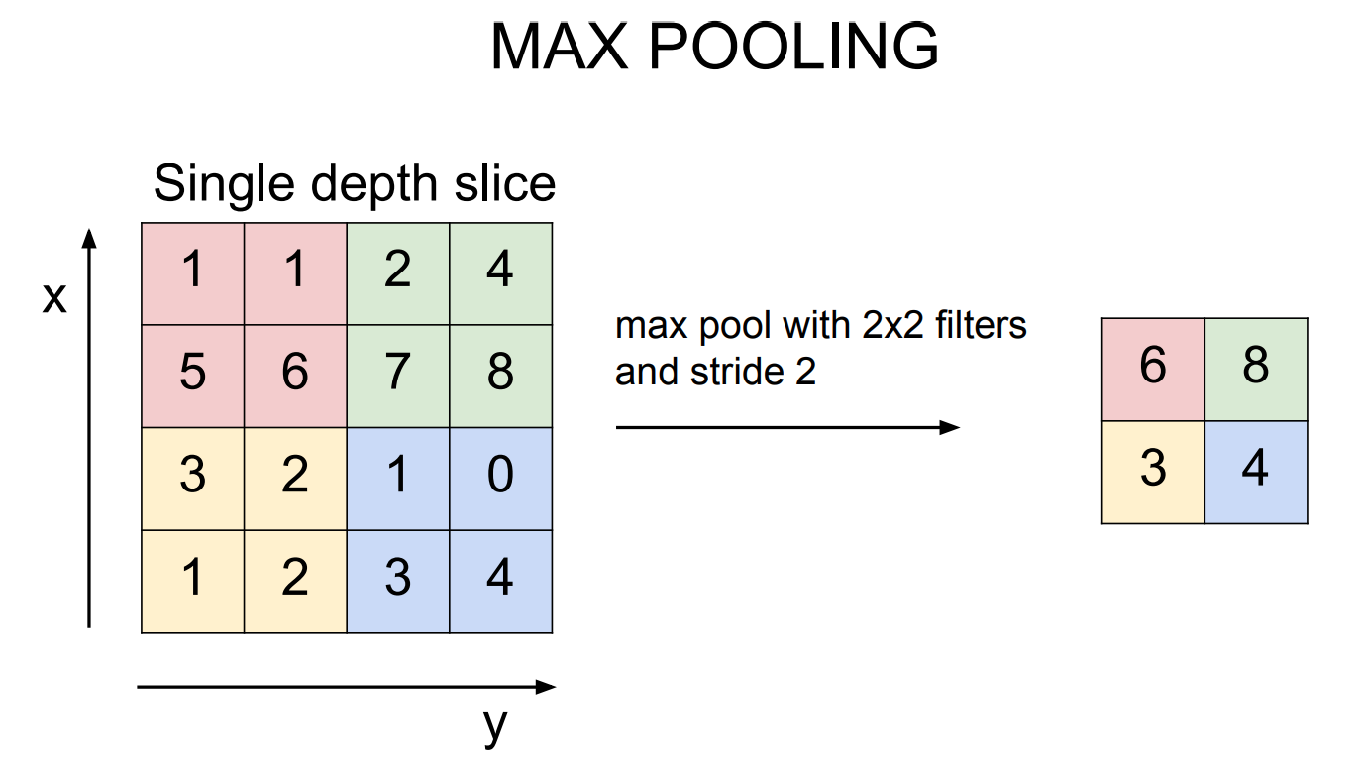
Image Classification with CNN

Slide 26
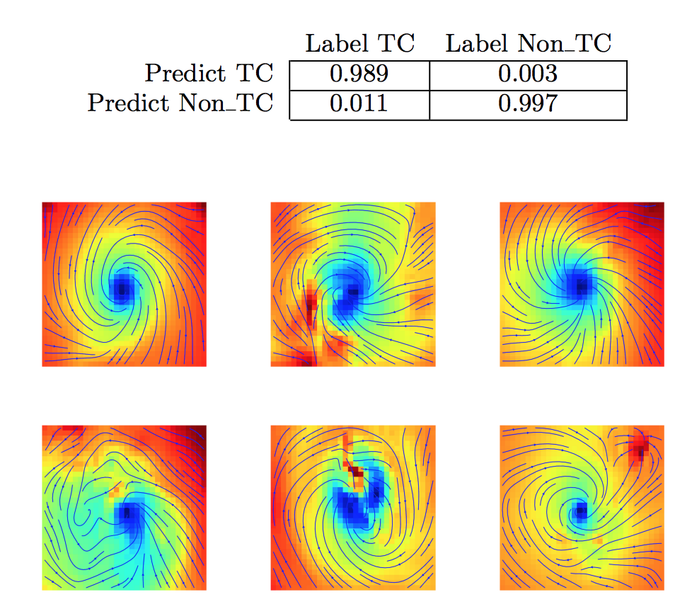
Application for Climate Science
Is is hurricane? (Binary Classification)
Labeled 2-d patches (Reanalysis and Simulation)
Yes
…
No
Liu, Yunjie, et al. "Application of deep convolutional neural networks for detecting extreme weather in climate datasets." arXiv preprint arXiv:1605.01156 (2016).

Slide 27
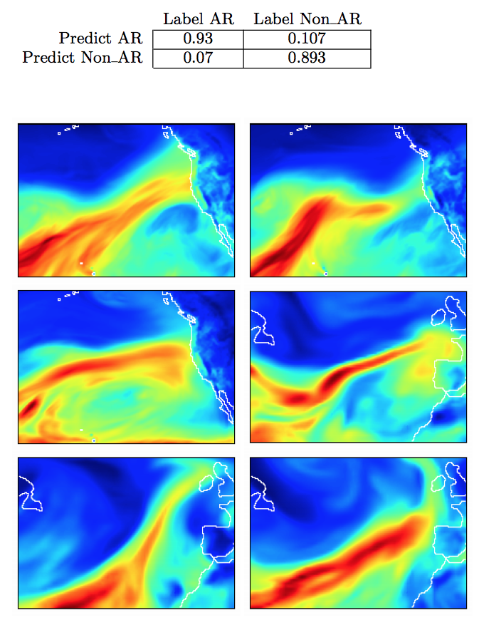
Application for Climate Science
Liu, Yunjie, et al. "Application of deep convolutional neural networks for detecting extreme weather in climate datasets." arXiv preprint arXiv:1605.01156 (2016).

Slide 28
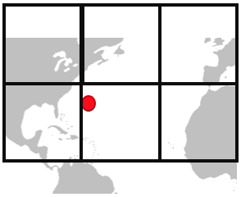
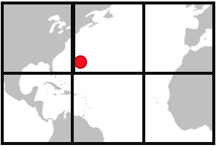
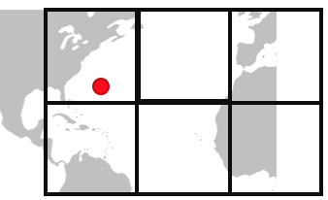
Application for Climate Science
Stage 1: Data Collection + Labeling
Stage 2: Detection
Stage 3: Localization
Crop by grids
Hurricane
x’ (longitude)
y’ (latitude)
…
Temperature
(x’₁,y’₁)
precipitation
:
Convolutional Neural Network
Where is the hurricane? (Regression)
(x,y)
wind
(x’₂,y’₂)
Yes
:
No
…
Climate data
Normal
Labeled by historical record
Convolutional Neural Network
Does it contain hurricane? (Classification)
Yes (x,y’)
No
No
Yes (x,y)
No
No
No
:
Climate Informatics. S. Kim et al. 2017
Notes:
Now, I would like to describe three approaches to detect and localize extreme climate event.
As the first task, we choose the hurricane as extreme event.
The detection and localization hurricane can be done in 3 stages.
- First, we collect data which came up hurricane in history
Lucky, hurricane have historical record. So, we could collect the labeled hurricane data from the record.
But, If there’s only few historical record of event, we will use few-shot learning techniques or Generative Adversarial network to generate labeled data based on few labeled data.
When we collect the event, we only collect the nearby bounding box.
In my case, I used 20 degree by 20 degree bounding box.
And randomly slide the bounding box several times to sustain “transient invariance”.
-In second stage, those labeled hurricane data will be the input of “detectionCNNs”, and “detection CNNs” learns to detect “yes” or “no” instance.
-In third stage, just for the ”yes” instance, “localization CNNs” learns to detect exact location-such as latitude and longitude-of hurricane.
(Once those two CNNs finishes learning, the input of this whole framework will be global climate data, and the output is detection result with exact location.)

Slide 29
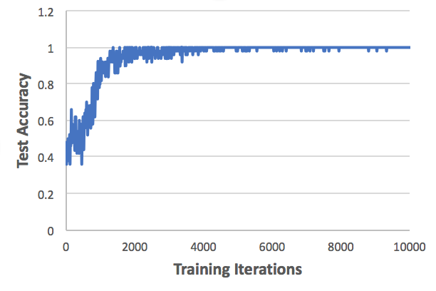
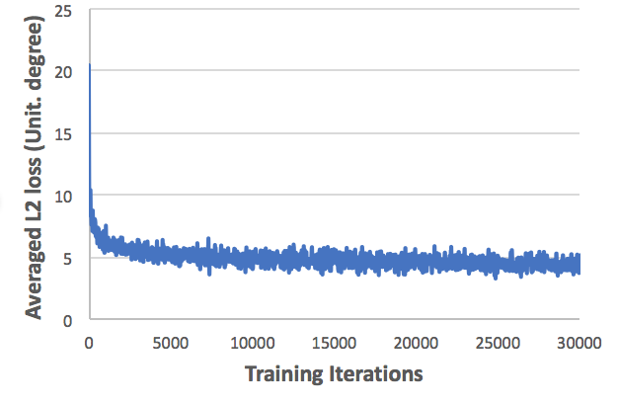
Application for Climate Science
Detection
Localization
Almost 100 % test accuracy for detection
Regression error (L2 loss) is ~ 4 degrees (about 450 km)
Notes:
Here is our main result for the hurricane detection and localization”.
For the detection CNNs, we have achieved almost 100% accuracy using our data.
For the localization CNNs, we have achieved around 4.5 degrees of regression error.
Considering that 1 degree is around 100km, that means CNNs localize hurricane with 450 km off from the true location which is not great.
We consider the reason for this poor localization accuracy is low resolution of data.
Then, how can we increase the localization accuracy without downscaling process?

